Slide 1


Smart Farming Management System:
Empowering Farmers with AI-Driven Smart Agriculture
By,
Harish Yuvaraj V S Naveen Kumar K Nithesh S Yogeshwaran M

Slide 2




Hhe Challe⭲ge Faci⭲g Modeĩ⭲ Faĩmeĩs
Indian farmers face critical barriers that limit productivity and income potential.
MaĩkeL I⭲foĩmaLio⭲ gap
Limited access to real-time market prices leads to poor selling decisions and reduced profits.
No DiĩecL Co⭲⭲ecLio⭲
Traditional intermediaries create inefficiencies, reducing farmer revenue significantly.
Cĩop Disease Ḻosses
Untreated diseases cause devastating yield losses without timely detection and intervention.
No Vield PĩedicLio⭲
Absence of AI-powered forecasting makes planning and resource allocation challenging.
Pooĩ Hĩacki⭲g
Limited tools for managing farm activities, expenses, and inventory efficiently.

Slide 3
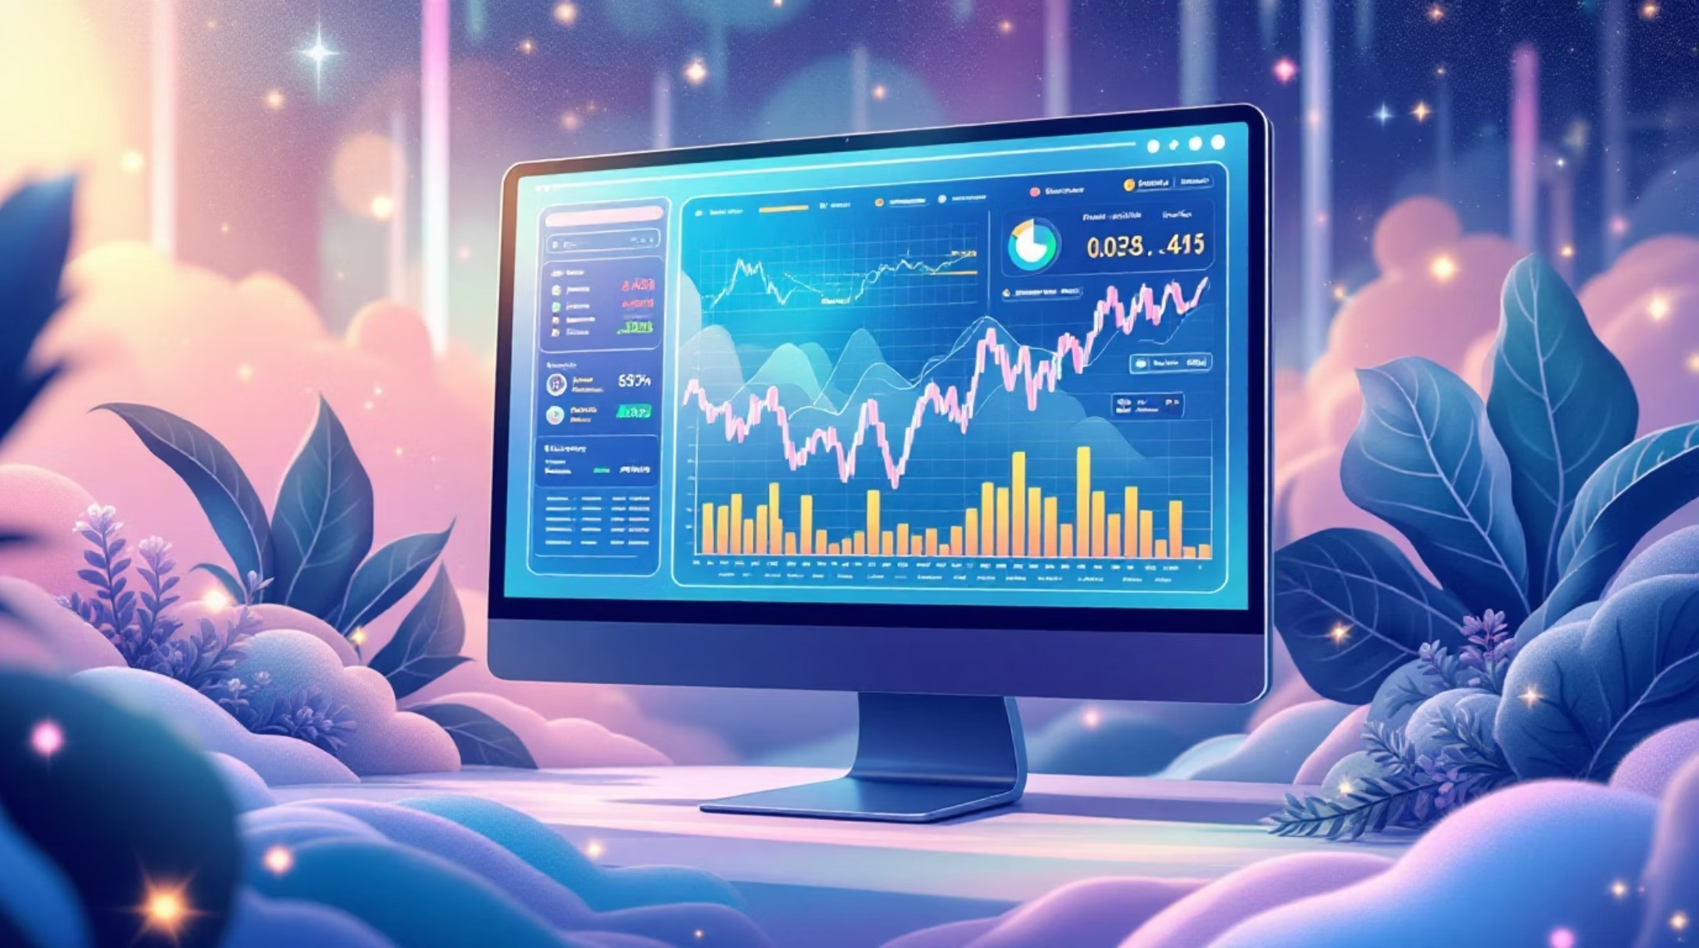
E…isLi⭲g SoluLio⭲s Fall ShoĩL
Cuĩĩe⭲L PlaLfoĩms
eNAM (National Agriculture Market) - limited functionality
AgriTech apps with basic AI support
Government portals with static, outdated data
Kev ḺimiLaLio⭲s
No real-time AI-powered insights
Limited crop disease detection
No integrated farm management
Poor user experience for farmers

Slide 4

Ouĩ 6I-Poweĩed SoluLio⭲
A comprehensive platform that transforms traditional farming into data-driven smart agriculture.
6I Vield PĩedicLio⭲
Machine learning models forecast crop yields based on historical data, weather patterns, and soil conditions.
DiĩecL MaĩkeLplace
Connect farmers directly with buyers through a transparent, commission- free platform.
Disease DeLecLio⭲
Upload crop images for instant AI-powered disease diagnosis and
treatment recommendations.
SmaĩL Recomme⭲daLio⭲s
Get personalized crop suggestions based on land type, season, market
demand, and profitability.
Faĩm Cale⭲daĩ
Integrated calendar tracks planting schedules, harvest dates, and key farming activities automatically.
6I ChaL SuppoĩL
24/7 multilingual assistant provides farming advice, disease solutions, and weather guidance.

Slide 5


SmaĩL Supplv ” MaĩkeL SvsLem
Supplv Hĩacki⭲g
Real-time monitoring of crop movement from farm to market
Pĩice Displav
Live crop rate updates across regional markets
Faĩmeĩ-Buveĩ Ḻi⭲k
Direct connections eliminate middlemen
Vield PĩedicLio⭲
AI forecasts expected harvest quantities

Slide 6

Cĩop I⭲Lellige⭲ce E⭲gi⭲e
How IL Woĩks
01
Upload Image
Capture or upload photo of affected crop
02
6I 6⭲alvsis
Deep learning model processes image instantly
03
Disease DeLecLio⭲
Identifies specific disease with confidence level
04
6ddiLio⭲al FeaLuĩes
HĩeaLme⭲L Pla⭲
Recommends solutions and preventive measures
Crop health analysis scoring
Historical disease patterns
Pest infestation detection
Preventive care alerts

Slide 7




Faĩm Ma⭲ageme⭲L Dashboaĩd
E…pe⭲se Hĩacki⭲g
Log all costs including seeds, fertilizers, pesticides, labor, and equipment. Generate expense reports by season or crop type.
I⭲ve⭲Loĩv Ma⭲ageme⭲L
Track stock levels of seeds, fertilizers, and harvested produce. Get low-stock alerts and reorder recommendations.
Faĩm 6cLiviLv Ḻog
Record daily activities like planting, irrigation, spraying,
and harvesting. Build historical performance data.
6⭲alvLics Dashboaĩd
Visualize trends, profitability, yield performance, and ROI
through interactive charts and graphs.

Slide 8
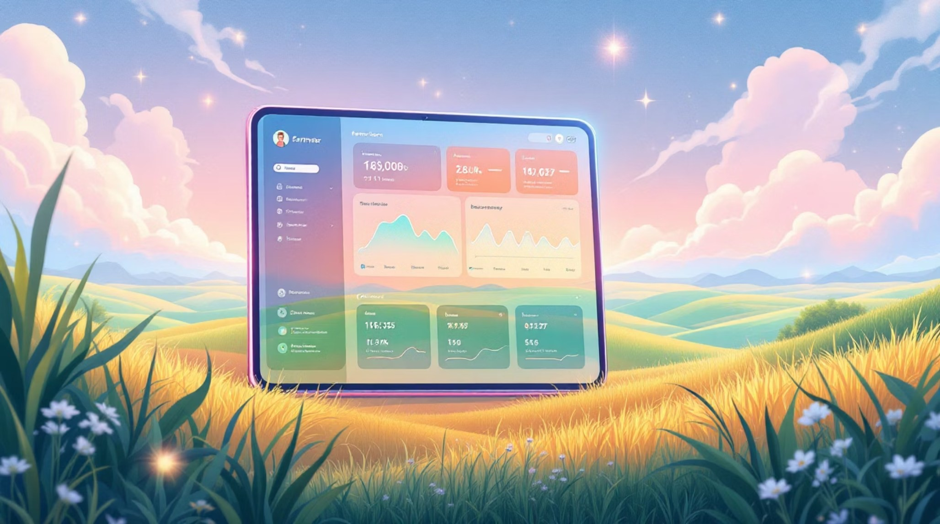
Compĩehe⭲sive Faĩmeĩ PoĩLfolio
Faĩmeĩ Pĩofile
Personal details, farming experience, contact information, and certifications
Ḻa⭲d DeLails
Field locations, soil type, water sources, total area, and land ownership documents
Cĩop HisLoĩv
Previous seasons' crops, yields, market prices,
and buyer transactions
PĩoducLio⭲ Recoĩds
Current season progress, expected harvest dates, and quality assessments

Slide 9
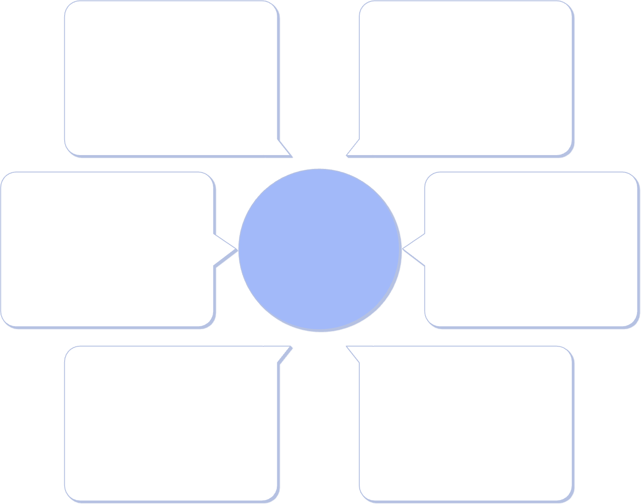
Hech⭲ologv SLack ” 6ĩchiLecLuĩe
Hech⭲ologv SLack 6I ChaL SuppoĩL
Frontend | React Native, Tailwind CSS
Backend | Node.js, Express.js
Database | PostgreSQL, MongoDB
AI/ML | TensorFlow, Python
APIs | RESTful, GraphQL
Cloud | AWS, Firebase
24/7 multilingual AI assistant
Farming advice and best practices
Disease diagnosis and solutions
Weather forecasts and guidance
Market updates and trends
SvsLem 6ĩchiLecLuĩe
E…Leĩ⭲al 6PIs
Market and weather data
ReacL NaLive Fĩo⭲Le⭲d
User interface and input
He⭲soĩFlow 6I Model
ML processing and
inference
Node.js Backe⭲d
API routing and business logic
DaLa Flow Pipeli⭲e
Mo⭲goDB DaLabase
Document-based storage
PosLgĩeSQḺ DaLabase
Relational data storage

Slide 10

FuLuĩe Visio⭲ ” ImpacL
L
Phase L: Ḻau⭲ch
Core platform with AI yield prediction and disease detection
?
Phase ?: IoH I⭲LegĩaLio⭲
Soil sensors, weather stations, automated irrigation control
3
Phase 3: Dĩo⭲e Mo⭲iLoĩi⭲g
Aerial crop analysis, NDVI mapping, precision agriculture
4
Phase 4: Blockchai⭲
Transparent supply chain, verified organic certification
SmaĩL Faĩmi⭲g = SmaĩL I⭲dia
By leveraging AI and modern technology, we're transforming traditional agriculture to improve farmer livelihoods, increase productivity, and build a sustainable future for Indian agriculture.

